Slide 1
(CS-422)Human Computer Interaction
Behraj Khan

Slide 2
Discipline of Human Computer Interaction
Relationship of Usability and Quality
Understand HCI Discipline
Interdisciplinary Nature of HCI

Slide 3
HCI
Neither study of Human nor the study of technology
What can the technology do?
How can you build it?
What are the possibilities?
What are the people doing and how would this fit in?
What they would do with it?
If we fail either of one the design will fail
Considering people while building something

Slide 4
Quality
Characteristic or attribute of something
The standard of something as measured against other things of similar kind
The degree of excellence of something
How good or bad something is
Quality is fitness for purpose or use
Quality is meeting the requirements of the customer now and in future

Slide 5
Software Quality
Functionality
Reliability
Usability
Efficiency
Maintainability
portability

Slide 6
Continue…

Slide 7
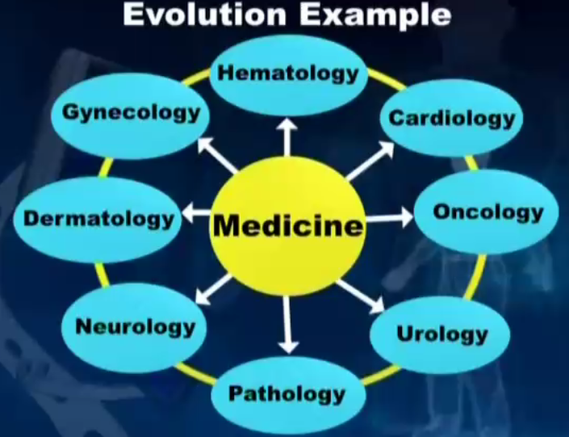
Interdisciplinary Nature of HCI
Notes:
Oncology: the study and treatment of tumours.
neurologisttreats disorders that affect the brain, spinal cord, and nerves

Slide 8
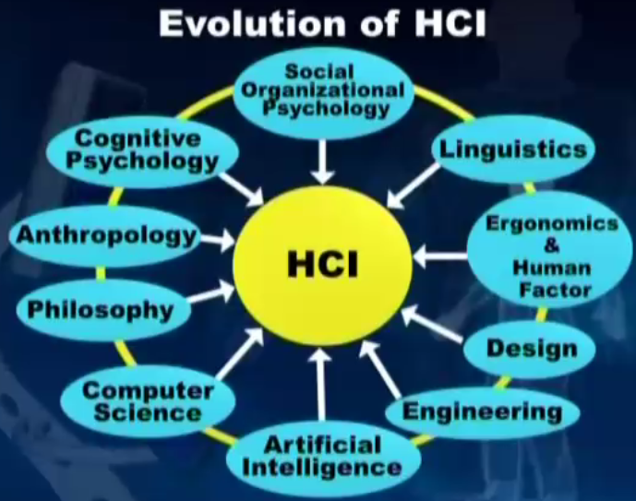
Continue…

Slide 9
Linguistic
the scientific study of language and its structure
Grammar of a language
Syntax of language
From HCI perspective
Language for commands
Applying knowledge and theories
Like in early days there was some debate about whether or not the object to which a command applied should come before or after the command itself
For example deleting a file ‘xyz’ you should type delete ‘xyz’ or ‘xyz’ delete

Slide 10
Ergonomics
the study of people's efficiency in their working environment
Keeping in mind the capabilities and limitations of user
Poor worksite design lead to frustration and hurting workers/users

Slide 11
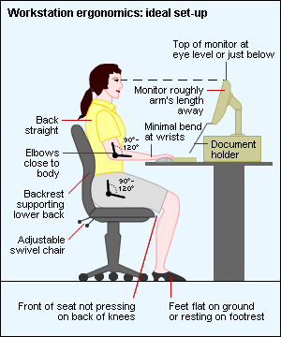

Continue…

Slide 12
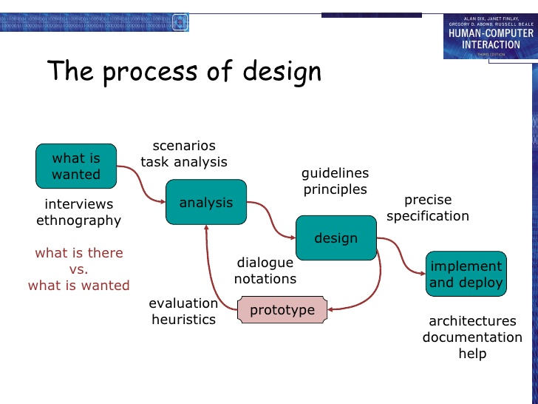
Design

Slide 13

Engineering
methodologies and systems for creating and assessing software

Slide 14
Engineering/Computer Science
faster machines
faster systems
means of building better interfaces

Slide 15
Philosophy
Is it possible to know anything and prove it?
Is there a best way to live ?
Do human have free will?
From HCI perspective
Computer supported cooperative writing
Crowd sourcing

Slide 16
Anthropology
The study of human, past and present
The more we know about socio-cultural and historical circumstances the users live in and act on
The more chances that we can design technologies that supports the users everyday work.

Slide 17
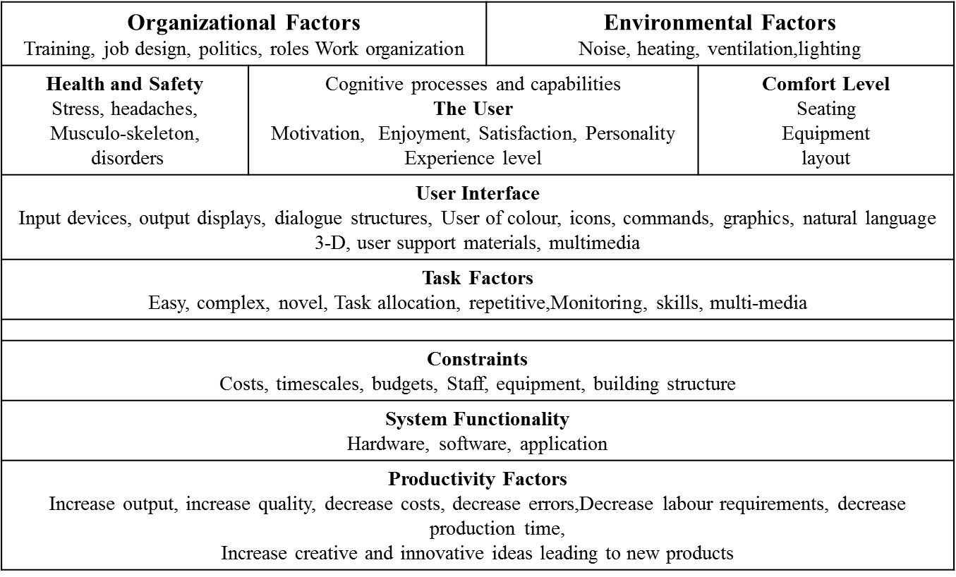
Factors in HCI

Slide 18
Projects
1- Facebook Non use
Investigating user who do not use Facebook
Analyzing their questions
Propose a better solution
Then evaluate from different users

Slide 19
2- Automatic Stress recognition in real life
Collect there call data from call center
Apply machine learning algorithms
Identify the stress
Or collect images data of a person
Apply machine learning algorithms
Identify stress

Slide 20
Interfaces that make us think
The advent of computers has made many things much easier in our lives. With mobile phone contact lists, we no longer have to memorize phone numbers, and with Google, we rarely have to remember anything because we can always just look it up again. Calculators and now advanced systems, like Wolfram Alpha, have reduced the need for being able to solve complex math problems. While these conveniences may have been good for our productivity and efficiency, there is still cognitive value to being encouraged to think and learn

Slide 21
Playing music which can change your mood
Music is a major element of social gatherings. However, creating playlists that suit everyone’s tastes and the mood of the group can require a large amount of manual effort. To solve this problem we present MoodMusic, a method to dynamically generate contextually appropriate music playlists for groups of people. MoodMusic uses speaker pitch and intensity in the conversation to determine the current ‘mood.’ It then queries the online music libraries of the speakers to choose songs appropriate for that mood.

Slide 22
Reducing Stress
Designing and evaluating interactive systems which may release the stress
http://st.sigchi.org/publications/toc/auto-ui-2017.html
http://st.sigchi.org/publications/toc/chi-2018.html

Slide 23
Adaptive Interfaces

